Slide 1

Web Base Ordering & Manufacturing management system
Project proposal presentation
8 April 2014
Miss. Nontra Mahachanont 542115026
Mr. Parinya Panyanak 542115034

Slide 2
agenda
Introduction
Problems
Solution
System review
Technology review
Development tools review
System Architecture
Deliverable
Limitation
Quality Assurance
Development Model
Schedule and Milestones

Slide 3






Introduction….
Wholesalers
Branches

Slide 4
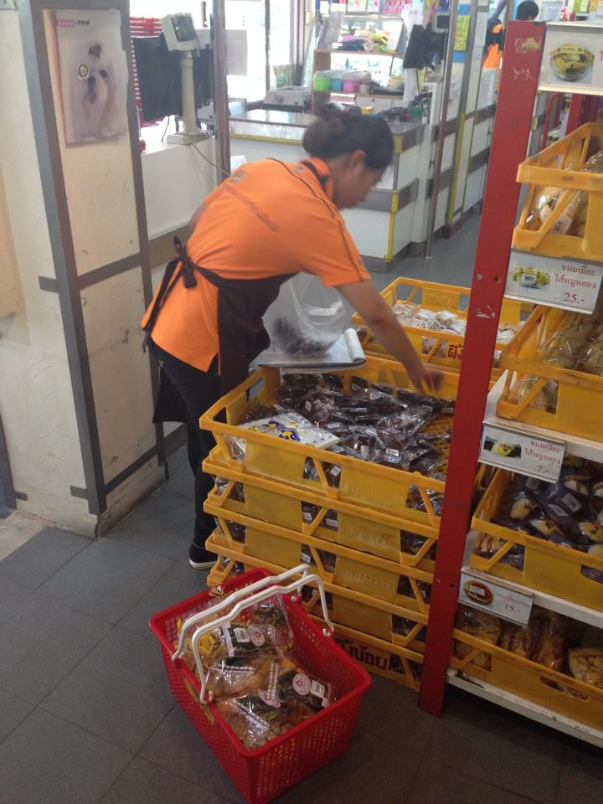
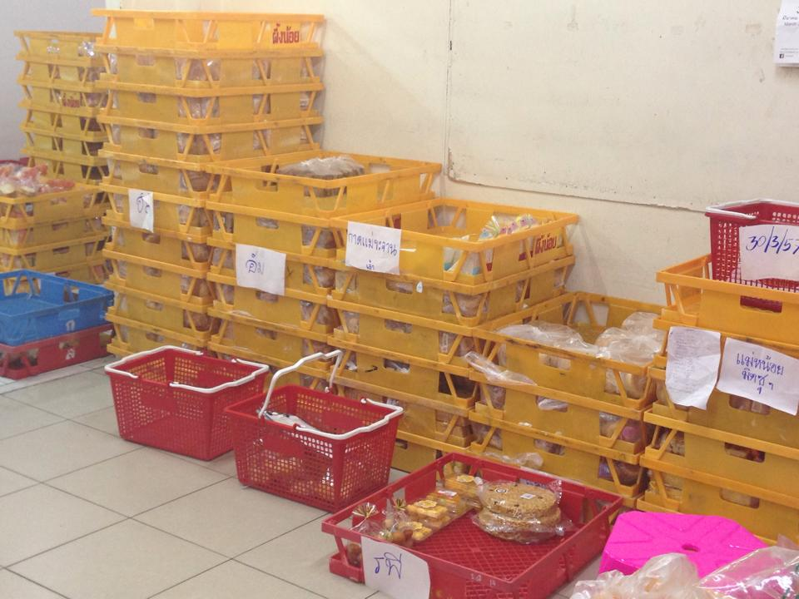

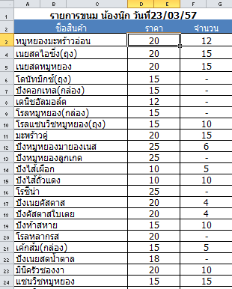
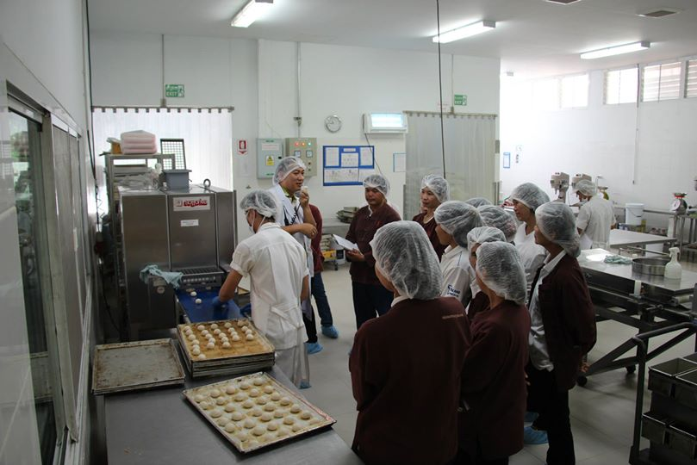
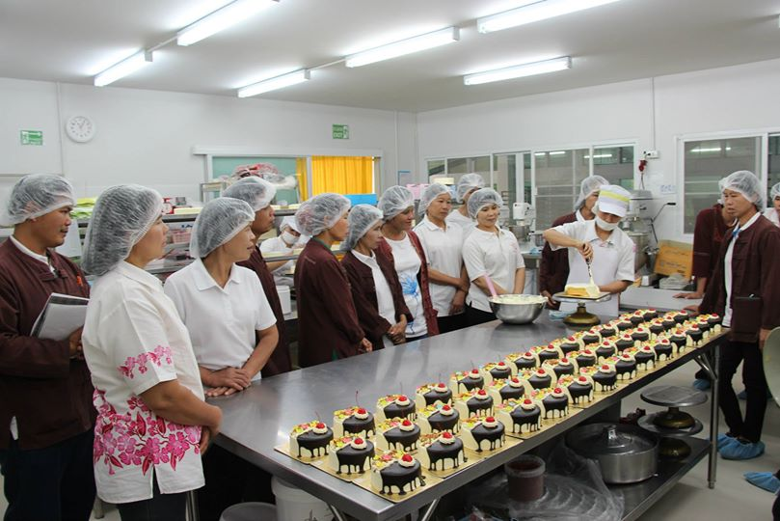
Introduction….

Slide 5
Ordering

Slide 6

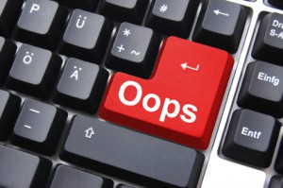
wholesalers

Slide 7
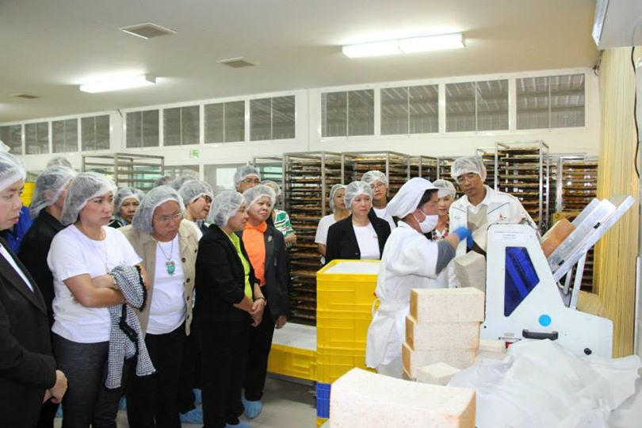
Manufacturing

Slide 8
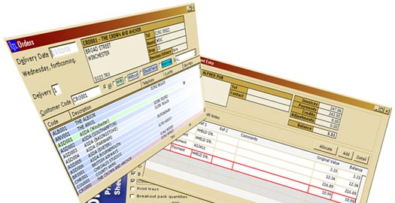

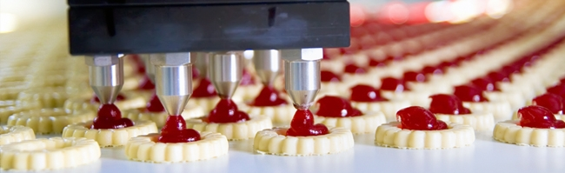
solution
Handle ordering information of manufacture
Facilitate wholesale manage their order
Determine the ingredients in manufacturing
Summary report in any problems

Slide 9
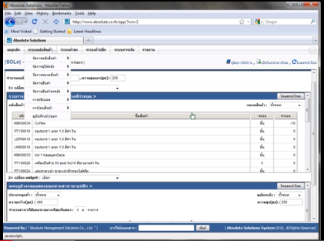
System reviews
Pros
All data is security from virus on machine.
The user can save investment.
Support using this web site with every operation system.
Support alert message with SMS and email.
Absolute |solution| website
Cons
Support only internet access areas.
No estimate the ingredients from ordering information.
No summary report system.

Slide 10
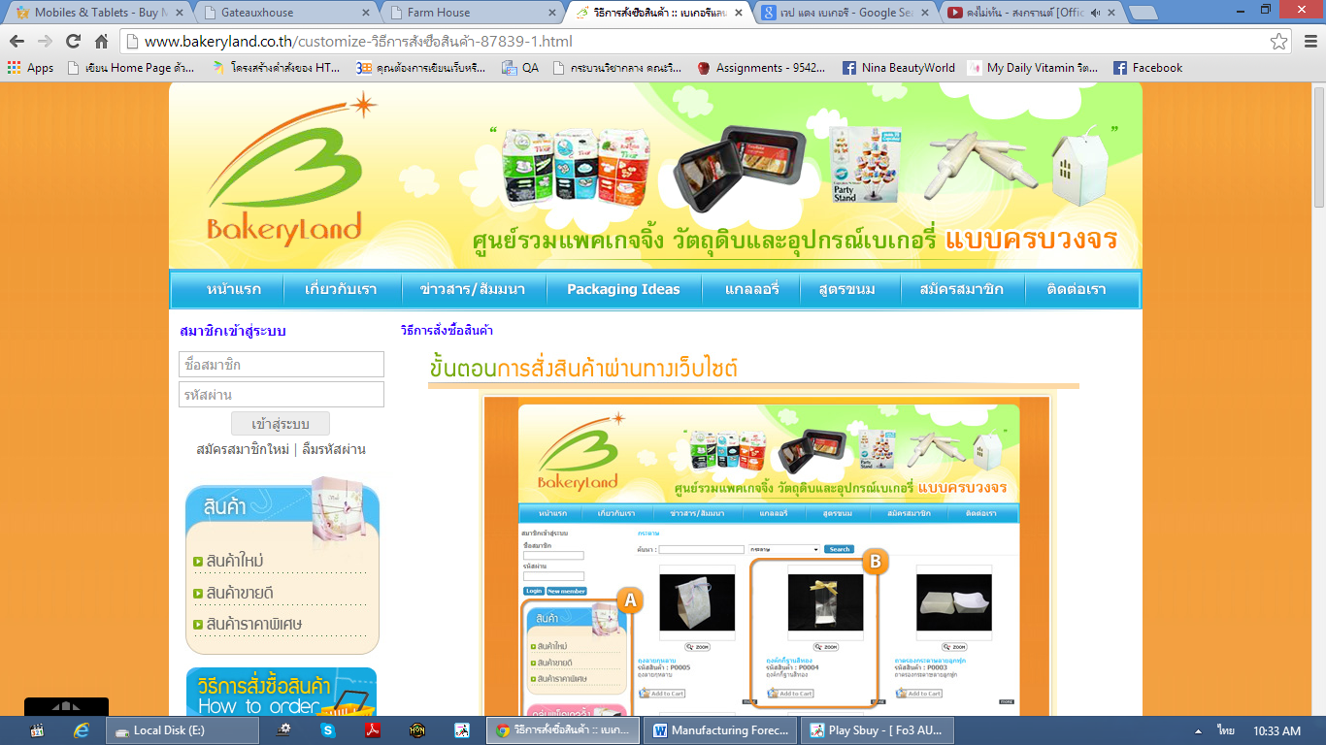
Bakery land website
Pros
The user can order the product through the website.
Have tutorial description for ordering.
Good category management.
Cons
Support only internet access areas.
No estimate the ingredients from ordering information.
No summary report system.

Slide 11
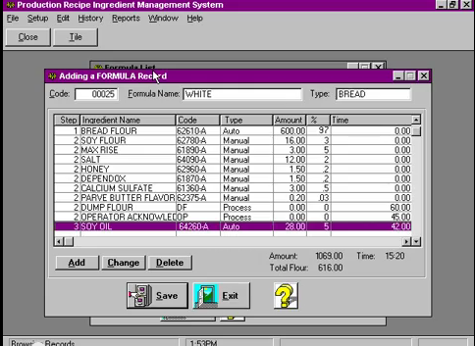
Prims software
Pros
Easy to use for no user experience to operation..
Flexible technology to control over manual operation.
Record each step in the process.
Fast and accuracy.
Cons
No membership and login support.
No online interactive.
No coverage report type function.

Slide 12



Technology reviews

Slide 13



Development tools reviews

Slide 14
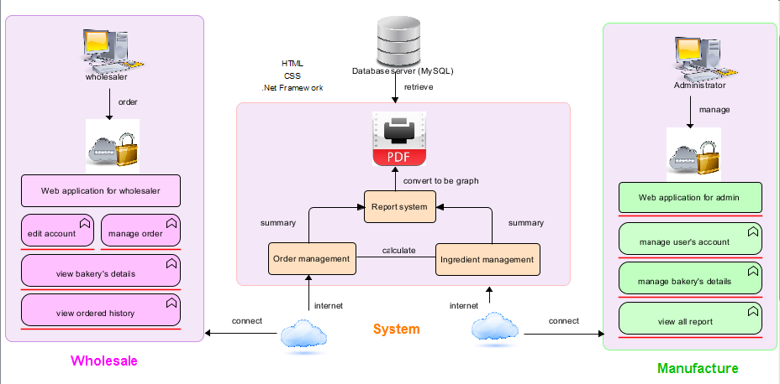
System architecture

Slide 15
Deliverables
Progress Report I
Feature#1: Member Management System
Wholesaler and admin can login to the system.
Wholesaler and admin can log out from the system.
Wholesaler and admin can edit their profile.
Wholesaler and admin can view their profile.
Admin can create accounts of users.
Admin can delete accounts of users.
Admin can edit accounts of users.
Admin can search user’s account by user ID and name.
Admin can specify user’s type.
Feature#2: Order Management System
Wholesaler and admin can search bakery details by
bakery’s name, type and price.
Wholesaler can make an order of bakery.
Wholesaler can repeat the ordered of bakery from their
history.
Wholesaler can save unfinished order of bakery.
Wholesaler can edit their submitted order.
Wholesaler can receive notification successful ordering
by SMS and email.
Admin can manage bakery’s details.
System can sort manufacturing date from order
information.

Slide 16
Progress Report II
Feature#3: Ingredient management System
Admin can manage details of bakery by provide the bakery’s name,
ingredient and bakery’s quantity.
Admin can manage ingredient type information.
System can calculate the actual number of bakery after the finished.
System can calculate ingredient will be used in manufacturing.
System can calculate ingredient will be used in each type.
System can calculate quantity goal in each bakery’s type.

Slide 17
Progress Report III
Feature#4: Summary Report System
Wholesaler can view their order history by day, month and year.
Admin can view wholesaler’s history by day, month and year.
Admin can view summary wholesale order by day, month and year.
Admin can search wholesaler’s history by name and ID.
Admin can make wholesalers order’s report.
Admin can make bakery preparation’s report.
Admin can make real production’s report.
Admin can make ingredient usage’s report.
Admin can make bakery quantity assurance’s report.
All report can convert to being a graph in PDF form.
Wholesaler and admin can print their report.

Slide 18

limitation
This application required Internet connection to execute.
This application supports only Phungnoi bakery manufacturer as a sample for developing and testing the system.
This application cannot support stock and billing system.
This application cannot integrate directly with existing software.
This application require web browser.
This application require database server.

Slide 19
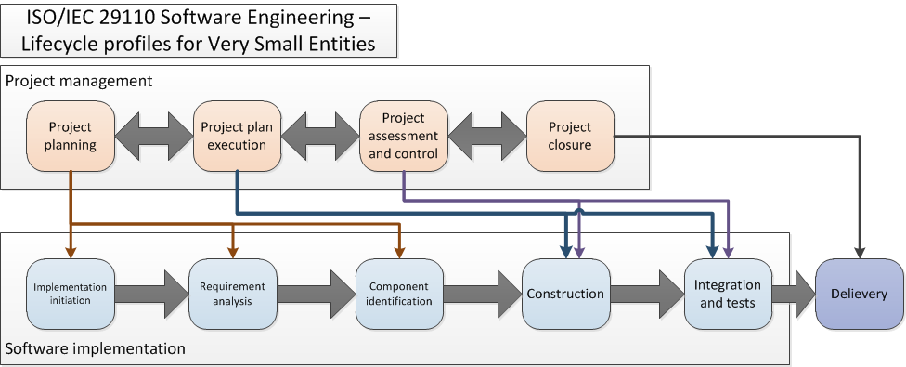
Quality & assurance

Slide 20
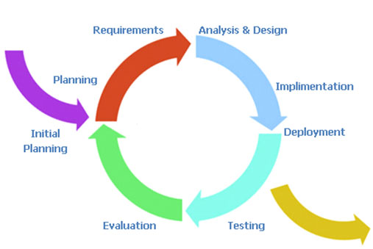
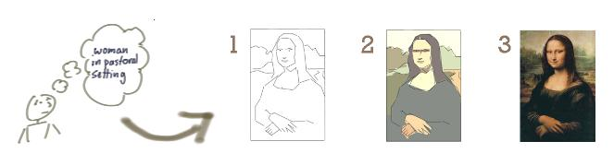
Development model
Iterative Software Development Process
idea → realization
“iterating” builds a rough version, validates it, then slowly builds up quality

Slide 21
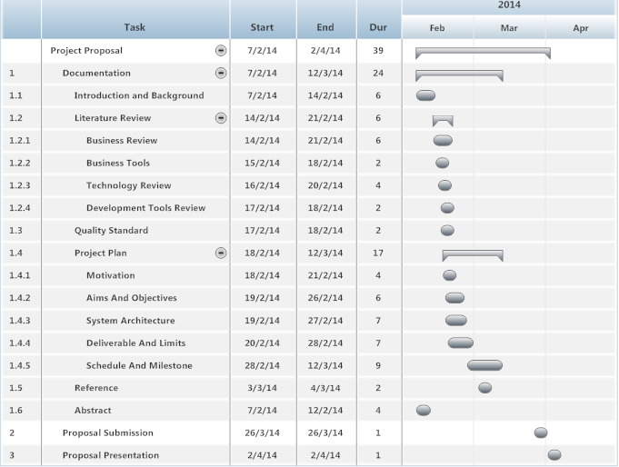
Schedule & milestone
Proposal

Slide 22
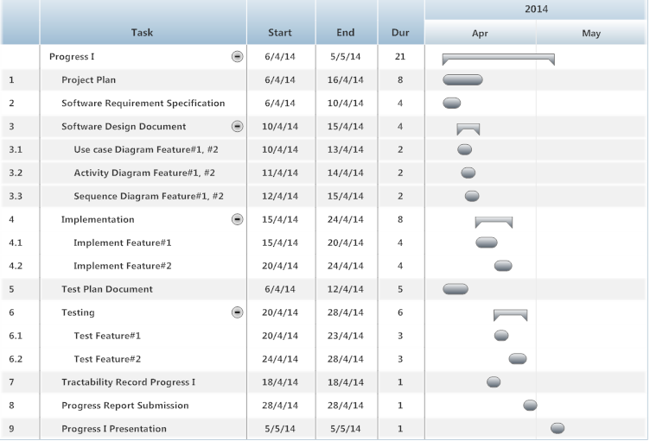
Progress report I

Slide 23
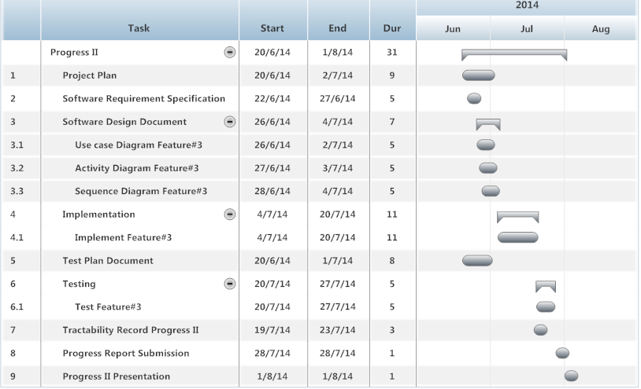
Progress report II

Slide 24
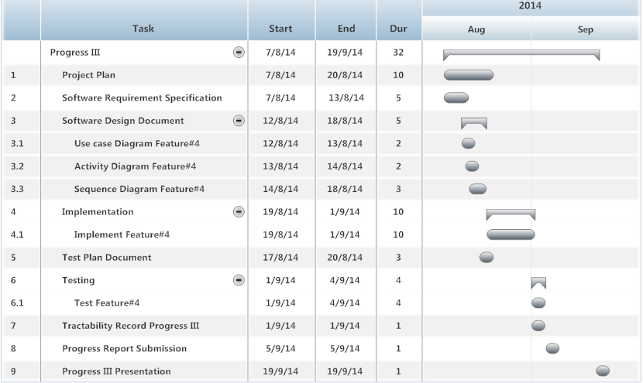
Progress report III

Slide 25
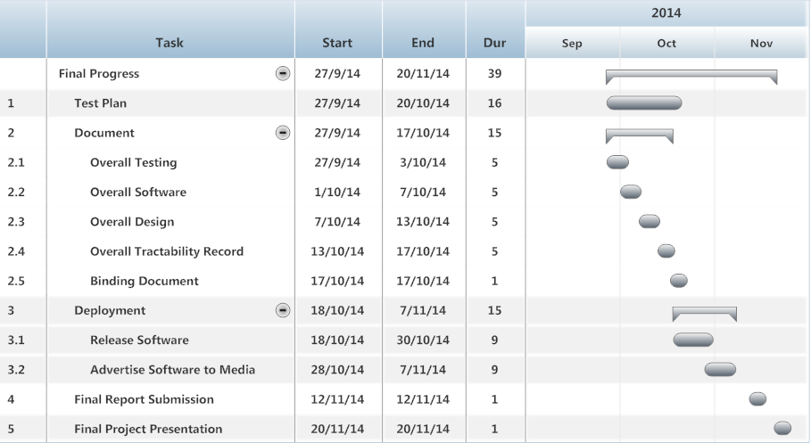
Final report

Slide 26

Q & A

